Slide 1
Pointer and one dimensional Arrays
The elements of an array are stored in contiguous memory locations. Suppose we have an array arr[5] of type int.
int Arr[5] = {1, 2, 3, 4, 5};
This is stored in memory as-
Main points:
Element of an array are stored in consecutive memory locations.
The name of an array is a constant pointer that points to the first element of the array i.e it stores the address of the first element, known as base address of array.
When a pointer variable is incremented, it points to the next location of its base type.
5000 | 5002 | 5004 | 5006 | 5008
1 | 2 | 3 | 4 | 5
Arr[0] | Arr[1] | Arr[2] | Arr[3] | Arr[4]

Slide 2
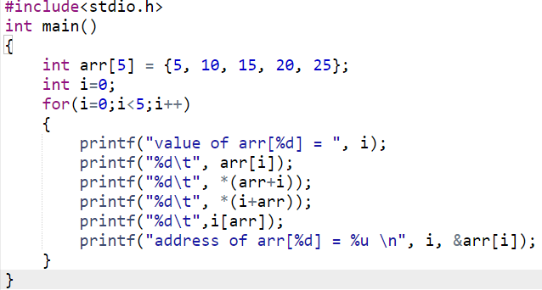
We can get the address of an element of array by applying & operator in front of subscripted variables name. Hence &Arr[0] gives address of 0th element .
In subscript notation the address of an array element is &arr[i] and its value is arr[i], while in pointer notation the address is (arr+i) and the element is *(arr+i);

Slide 3
Output of the above program
value of arr[0] = 5 5 5 5
address of arr[0] = 7808
value of arr[1] = 10 10 10 10
address of arr[1] = 7812
value of arr[2] = 15 15 15 15
address of arr[2] = 7816
value of arr[3] = 20 20 20 20
address of arr[3] = 7820
value of arr[4] = 25 25 25 25
address of arr[4] = 7824

Slide 4
Subscripting pointer variable
Suppose we take a pointer variable ptr, and initialize it with the address of 0th element of the array.
int *ptr;
ptr = arr; // we could also write ptr = &arr[0]
ptr pointing the 0th element of the array. We can access the element of the array by subscripting that pointer variable.
Diff b/w name of an array and a pointer variable.
The name of an array is a constant pointer hence it will always point to the 0th element of the array. It is not a variable , hence we can’t assign some other address to it neither can we move it by incrementing or decrementing.
arr = &num;
arr++ invalid
arr = arr-1
ptr = &num;
ptr++; valid
Ptr = ptr-1

Slide 5
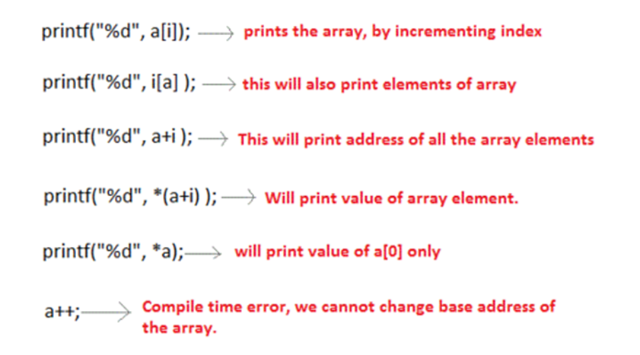
Example:

Slide 6
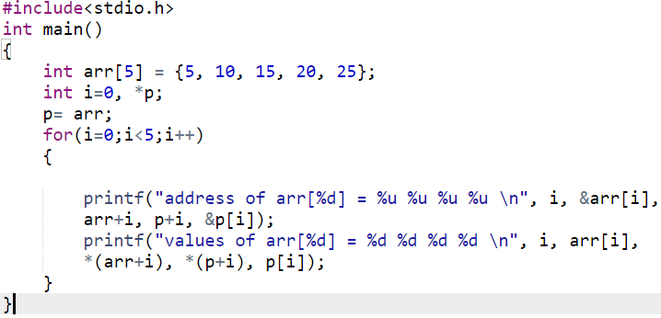
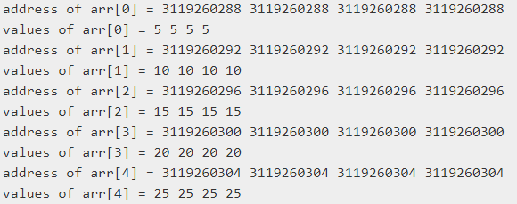

Slide 7
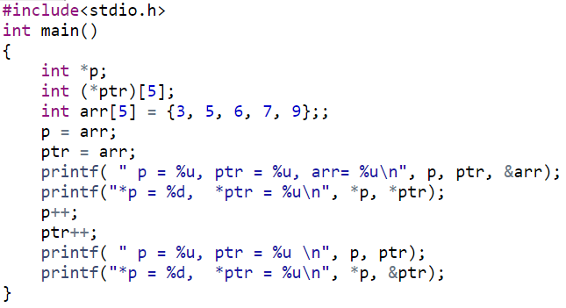
Pointer to an array
We can also declare a pointer that can point to the whole array instead of only one element of array.
Useful in multidimensional array.
Syntax: data_type (*var_name)[size_of_array];
Declaration: int (*ptr)[10]; // ptr is a pointer that can point to an array of 10 integers.
p = 9584, ptr = 9584, arr= 9584
*p = 3, *ptr = 9584
p = 9588, ptr = 9604
*p = 5, *ptr = 9604

Slide 8
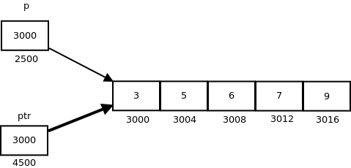
p: is pointer to 0th element of the array arr, while ptr is a pointer that points to the whole array arr.
The base type of p is int while base type of ptr is ‘an array of 5 integers’.
We know that the pointer arithmetic is performed relative to the base size, so if we write ptr++, then the pointer ptr will be shifted forward by 20 bytes.
On dereferencing a pointer expression we get a value pointed to by that pointer expression.
Pointer to an array points to an array, so on dereferencing it, we should get the array, and the name of array denotes the base address.
So whenever a pointer to an array is dereferenced, we get the base address of the array to which it points.

Slide 9
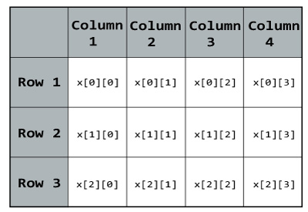
Pointers and two dimensional arrays
The element of 2-D array can be accessed with the help of pointer notation. Suppose arr is a 2 –D array, then we can access any element arr[i][j] of this array using the pointer expression
*( *(arr+i)+j).
Example: float x[3][4]; pointer notation: float (*x)[4]
Here, x is a two-dimensional (2d) array. The array can hold 12 elements. You can think the array as table with 3 row and each row has 4 column.

Slide 10
Int arr[3][4] = { {10, 11, 12, 13}, {20, 21, 22, 23},{30, 31, 32, 33}};
Since memory is organized linearly in computer. It is not possible to store directly 2-D array. Actually 2-D arrays are stored in row major and column major order.
Row major order: each rows are placed next to each other.
 | Col0 | Col1 | Col2 | col3
Row0 | 10 | 11 | 12 | 13
Row1 | 20 | 21 | 22 | 23
row2 | 30 | 31 | 32 | 33
arr[0][0] |  |  |  | arr[1][0] |  |  |  | arr[2][0]
10 | 11 | 12 | 13 | 20 | 21 | 22 | 23 | 30 | 31 | 32 | 33
5000 | 5002 | 5004 | 5006 | 5008 | 5010 | 5012 | 5014 | 5016 | 5018 | 5020 | 5022

Slide 11
Each row can be considered as a 1-D array, so 2-D array can be considered as a collection of 1-D arrrays that are placed one after other.
Name of 2-D array represents a pointer to a 1-D array.
In the above example arr is pointer to 0th 1-D array and contains a address 5000.
Since arr is a ‘pointer to an array of 4 integers’, expression (arr+1) will represent the address 5008 and (arr+2) will represent address 5016.
Both the expressions (arr + i) and *(arr + i) are pointers, but their base type are different. The base type of (arr + i) is ‘an array of 4 units’ while the base type of *(arr + i) or arr[i] is int.
arr –points to 0th 1-D array – 5000
arr+1 – points to 1st 1-D array – 5008
arr+2 – points to 2nd 1-D array -5016
 | Col0 | Col1 | Col2 | col3
arr | 10 | 11 | 12 | 13
(arr+1) | 20 | 21 | 22 | 23
(arr+2) | 30 | 31 | 32 | 33

Slide 12
*(arr+i) = arr[i] – base address of ith 1-D array – points to 0th element of ith 1-D array.
Since the base type of *(arr+i) is int and it contains the address of 0th element of ith 1-D array, we can get the address of subsequent elements in the ith 1-D array by adding integer value to *(arr+i). Example: *(arr+i)+1 will point the address of 1st element of ith 1-D array.
Similarly *(arr+i)+j will represent the address of jth element of ith 1-D array. Dereferencing this exp we can get the jth element of ith 1-D array. Example *(*(arr+i)+j) represent the value of jth element of ith 1-D array.
 | *arr
arr | 10 | 11 | 12 | 13
(arr+1) | 20 | 21 | 22 | 23
(arr+2) | 30 | 31 | 32 | 33
 | *(arr+2) |  |  | *(arr+2)+3
*(*(arr+2)+3)

Slide 13
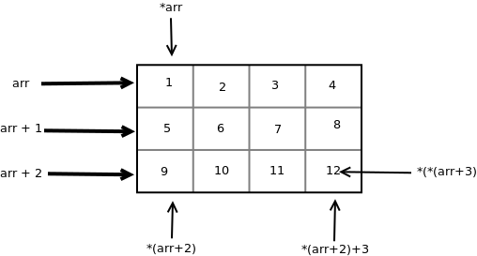
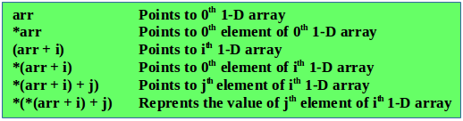
*(*(arr+2)+3)

Slide 14
// C program to print the values and address of elements of a 2-D array
#include<stdio.h>
int main()
{
int arr[3][4] = { { 10, 11, 12, 13 }, { 20, 21, 22, 23 }, { 30, 31, 32, 33 } };
int i, j;
for (i = 0; i < 3; i++)
{
printf("Address of %dth array = %u %u\n", i, arr[i], *(arr + i));
for (j = 0; j < 4; j++)
printf("%d %d ", arr[i][j], *(*(arr + i) + j));
printf("\n");
}
return 0;
}
Output:
Address of 0th array = 9520 9 520
10 10 11 11 12 12 13 13
Address of 1th array = 9536 9536
20 20 21 21 22 22 23 23
Address of 2th array = 9552 9552
30 30 31 31 32 32 33 33

Slide 15
int B[2][3];
In memory two 1-D array of three elements will be created.
int * p=B; // not a proper method, gives you waning in codeblocks //although executes ( because B will return a pointer to 1-D //array of three integers).
So we need to declare pointer to array to hold the address of B. Such as
int(*p)[3]=B;
If we use the following statement :
printf(“%u”,B); // it will print base address of B.
printf(“%u”,B+1); // it will print base address+ size of 1-D array
printf(“%u”,*(B+1)); // it will print address of b[1][0]
printf(“%u”,*(B+1)+2); // it will print address of B[1][2]

Slide 16
Example
#include <stdio.h>
int main() {
int i, arr[3][4] = { {10, 11, 12, 13}, {20, 21, 22, 23},{30, 31, 32, 33}};
int (*ptr)[4];
ptr=arr;
printf("ptr = %u, ptr+1 = %u, ptr+2 = %u\n", ptr, ptr+1, ptr+2);
printf("*ptr = %u, *(ptr+1) = %u, *(ptr+2) = %u\n", *ptr, *(ptr+1), *(ptr+2));
printf("value ptr = %d, value ptr+1 = %d, value ptr+2 = %d\n", **ptr, *(*(ptr+1)+2), *(*(ptr+2)+3));
printf("value ptr[0][0] = %d, value ptr[1][2] = %d, value ptr[2][3] = %d\n", ptr[0][0], ptr[1][2], ptr[2][3]);
return 0;
}
ptr = 9376, ptr+1 = 9392, ptr+2 = 9408
*ptr = 9376, *(ptr+1) = 9392, *(ptr+2) = 9408
value ptr = 10, value ptr+1 = 22, value ptr+2 = 33
value ptr[0][0] = 10, value ptr[1][2] = 22, value ptr[2][3] = 33

Slide 17
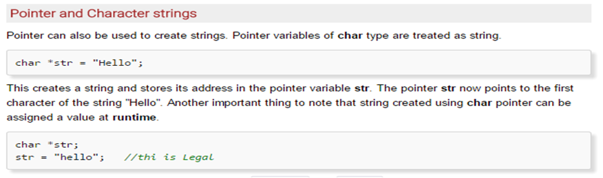
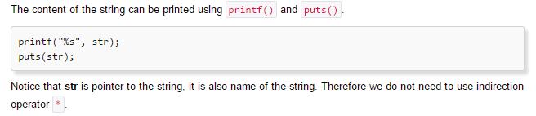

Slide 18
Pointer Arithmetic and Array
float a[4];
float *ptr;
ptr = &(a[2]);
*ptr = 3.14;
ptr++;
*ptr = 9.0;
ptr = ptr - 3;
*ptr = 6.0;
ptr += 2;
*ptr = 7.0;
Data Table
Name | Type | Description | Value
a[0] | float | float array element (variable) | ?
a[1] | float | float array element (variable) | ?
a[2] | float | float array element (variable) | ?
a[3] | float | float array element (variable) | ?
ptr | float * | float pointer variable
*ptr | float | de-reference of float pointer variable | ?

Slide 19
Pointer Arithmetic and Array
float a[4];
float *ptr;
ptr = &(a[2]);
*ptr = 3.14;
ptr++;
*ptr = 9.0;
ptr = ptr - 3;
*ptr = 6.0;
ptr += 2;
*ptr = 7.0;
Data Table
Name | Type | Description | Value
a[0] | float | float array element (variable) | ?
a[1] | float | float array element (variable) | ?
a[2] | float | float array element (variable) | ?
a[3] | float | float array element (variable) | ?
ptr | float * | float pointer variable | address of a[2]
*ptr | float | de-reference of float pointer variable | ?

Slide 20
Pointer Arithmetic and Array
float a[4];
float *ptr;
ptr = &(a[2]);
*ptr = 3.14;
ptr++;
*ptr = 9.0;
ptr = ptr - 3;
*ptr = 6.0;
ptr += 2;
*ptr = 7.0;
Data Table
Name | Type | Description | Value
a[0] | float | float array element (variable) | ?
a[1] | float | float array element (variable) | ?
a[2] | float | float array element (variable) | 3.14
a[3] | float | float array element (variable) | ?
ptr | float * | float pointer variable | address of a[2]
*ptr | float | de-reference of float pointer variable | 3.14

Slide 21
Pointer Arithmetic and Array
float a[4];
float *ptr;
ptr = &(a[2]);
*ptr = 3.14;
ptr++;
*ptr = 9.0;
ptr = ptr - 3;
*ptr = 6.0;
ptr += 2;
*ptr = 7.0;
Data Table
Name | Type | Description | Value
a[0] | float | float array element (variable) | ?
a[1] | float | float array element (variable) | ?
a[2] | float | float array element (variable) | 3.14
a[3] | float | float array element (variable) | ?
ptr | float * | float pointer variable | address of a[3]
*ptr | float | de-reference of float pointer variable | ?

Slide 22
Pointer Arithmetic and Array
float a[4];
float *ptr;
ptr = &(a[2]);
*ptr = 3.14;
ptr++;
*ptr = 9.0;
ptr = ptr - 3;
*ptr = 6.0;
ptr += 2;
*ptr = 7.0;
Data Table
Name | Type | Description | Value
a[0] | float | float array element (variable) | ?
a[1] | float | float array element (variable) | ?
a[2] | float | float array element (variable) | 3.14
a[3] | float | float array element (variable) | 9.0
ptr | float * | float pointer variable | address of a[3]
*ptr | float | de-reference of float pointer variable | 9.0

Slide 23
Pointer Arithmetic and Array
float a[4];
float *ptr;
ptr = &(a[2]);
*ptr = 3.14;
ptr++;
*ptr = 9.0;
ptr = ptr - 3;
*ptr = 6.0;
ptr += 2;
*ptr = 7.0;
Data Table
Name | Type | Description | Value
a[0] | float | float array element (variable) | ?
a[1] | float | float array element (variable) | ?
a[2] | float | float array element (variable) | 3.14
a[3] | float | float array element (variable) | 9.0
ptr | float * | float pointer variable | address of a[0]
*ptr | float | de-reference of float pointer variable | ?

Slide 24
Pointer Arithmetic and Array
float a[4];
float *ptr;
ptr = &(a[2]);
*ptr = 3.14;
ptr++;
*ptr = 9.0;
ptr = ptr - 3;
*ptr = 6.0;
ptr += 2;
*ptr = 7.0;
Data Table
Name | Type | Description | Value
a[0] | float | float array element (variable) | 6.0
a[1] | float | float array element (variable) | ?
a[2] | float | float array element (variable) | 3.14
a[3] | float | float array element (variable) | 9.0
ptr | float * | float pointer variable | address of a[0]
*ptr | float | de-reference of float pointer variable | 6.0

Slide 25
Pointer Arithmetic and Array
float a[4];
float *ptr;
ptr = &(a[2]);
*ptr = 3.14;
ptr++;
*ptr = 9.0;
ptr = ptr - 3;
*ptr = 6.0;
ptr += 2;
*ptr = 7.0;
Data Table
Name | Type | Description | Value
a[0] | float | float array element (variable) | 6.0
a[1] | float | float array element (variable) | ?
a[2] | float | float array element (variable) | 3.14
a[3] | float | float array element (variable) | 9.0
ptr | float * | float pointer variable | address of a[2]
*ptr | float | de-reference of float pointer variable | 3.14

Slide 26
Pointer Arithmetic and Array
float a[4];
float *ptr;
ptr = &(a[2]);
*ptr = 3.14;
ptr++;
*ptr = 9.0;
ptr = ptr - 3;
*ptr = 6.0;
ptr += 2;
*ptr = 7.0;
Data Table
Name | Type | Description | Value
a[0] | float | float array element (variable) | 6.0
a[1] | float | float array element (variable) | ?
a[2] | float | float array element (variable) | 7.0
a[3] | float | float array element (variable) | 9.0
ptr | float * | float pointer variable | address of a[2]
*ptr | float | de-reference of float pointer variable | 7.0

Slide 27
Passing 1-D array to a function
a single array element or an entire array can be passed to a function. This can be done for both one-dimensional array or a multi-dimensional array.
Using call by reference:
#include <stdio.h>
void disp( int *num)
{
printf("%d ", *num);
}
int main()
{
int arr[] = {1, 2, 3, 4, 5, 6, 7, 8, 9, 0};
for (int i=0; i<10; i++)
{
/* Passing addresses of array elements*/
disp (&arr[i]);
}
return 0;
}
O/p 1 2 3 4 5 6 7 8 9 0

Slide 28
Entire array to a function as an argument
#include <stdio.h>
void myfuncn( int *var1, int var2)
{/* The pointer var1 is pointing to the first element of the array and the var2 is the size of the array. In the loop we are incrementing pointer so that it points to the next element of the array on each increment.
for(int x=0; x<var2; x++)
{ printf("Value of var_arr[%d] is: %d \n", x, *var1);
/*increment pointer for next element fetch*/
var1++;
}
}
int main() {
int var_arr[] = {11, 22, 33, 44, 55, 66, 77};
myfuncn(var_arr, 7);
return 0;
}

Slide 29
Passing 2-D array in function
Pointer to an array of 3 integers(size of 1-D)
# include <stdio.h>
void show(int (*)[3],int,int);
int main()
{
int a[3][3]={{1,2,3},{4,5,6},7,8,9};
show(a,3,3);
return(0);
}
Output: 1 2 3
4 5 6
7 8 9
void show(int (*p)[3],int row,int col)
{
int i,j;
printf("\n\n\n");
for(i=0;i<row;i++)
{
for(j=0;j<col;j++)
printf("\t %d",p[i][j]);
printf("\n");
}
}

Slide 30
Array of pointers
We can declare an array that contains pointers as its element. Every element of this array is a pointer vriable that can hold the address of any variable of appropriate type.
Syntax: datatype *arrayname[size];
Example: int *arr[10];
a | b | c
5 | 10 | 15
2012 | 2560 | 3020
pa[0] = 2293516 *pa[0] = 5
pa[1] = 2293512 *pa[1] = 10
pa[2] = 2293508 *pa[2] = 15
5
10
15
# include <stdio.h>
int main()
{
int *pa[3];
int i, a=5, b=10, c=15;
pa[0]= &a;
pa[1]=&b;
pa[2]=&c;
for(i=0;i<3;i++)
{
printf("pa[%d] = %u\t",i,pa[i]);
printf("*pa[%d] = %d\n",i,*pa[i]);
}
}
pa[0] | pa[1] | pa[2]
2012 | 2560 | 3020
5000 | 5002 | 5004

Slide 31
Example2: Array of pointers can also contain address of elements of another array
# include <stdio.h>
int main()
{
int i, arr[4] = {5, 10, 15, 20};
int *pa[4];
for(i=0;i<4;i++)
pa[i] = &arr[i];
for(i=0;i<4;i++)
{
printf("pa[%d] = %u\t",i,pa[i]);
printf("*pa[%d] = %d\n",i,*pa[i]);
}
}
arr[0] | arr[1] | arr[2] | arr[3]
5 | 10 | 15 | 20
1000 | 1002 | 1004 | 1006
pa[0] | pa[1] | pa[2] | pa[3]
1000 | 1002 | 1004 | 1006
5000 | 5002 | 5004 | 5006
pa[0] = 8992 *pa[0] = 5
pa[1] = 8996 *pa[1] = 10
pa[2] = 9000 *pa[2] = 15
pa[3] = 9004 *pa[3] = 20

Slide 32
An array of pointers of size (2D array rows) is declared and each pointer in this array is assigned the address of 0th element of each row of the 2-D array i.e ith element of pa is a pointer to 0th element of ith row of a 2-D array.
# include <stdio.h>
int main()
{
int i,j, arr[3][4] = {{10,11,12,13},{20,21,22,23},{30,31,32,33}};
int *pa[3];
for(i=0;i<3;i++)
pa[i] = arr[i];
for(i=0;i<3;i++)
{
for(j=0;j<4;j++)
printf(" %d ",pa[i][j]);
printf("\n");
}
}
 |  |  | 5000
Pa[0] | 5000 |  | 10 | 11 | 12 | 13
Pa[1] | 5008 |  | 20 | 21 | 22 | 23
Pa[2] | 5016 |  | 30 | 31 | 32 | 33
Output:
10 11 12 13
20 21 22 23
30 31 32 33

Slide 33
Void pointers
A pointer to void is a generic pointer that can point to any data type.
If we have a pointer to int, then it would be incorrect to assign the address of a float variable to it but using void pointer we can store.
Void pointer is:
void *vpt;
int i=2, *ip = &i;
float f=2.3, *fp=&f;
double d;
void *vp;
ip=fp;
vp=ip;
vp=fp;
vp=&d

Slide 34
PROGRAM 9-1
Demonstrate Use of Pointers

Slide 35
PROGRAM 9-1
Demonstrate Use of Pointers

Slide 36
PROGRAM 9-3
Add Two Numbers Using Pointers

Slide 37
PROGRAM 9-3
Add Two Numbers Using Pointers

Slide 38
Dynamic memory allocation
Dynamic memory allocation is the allocation of memory storage for use in a computer program during the runtime of that program.
Four Dynamic Memory Allocation Functions:
Allocate memory - malloc(), calloc(), and realloc()
Free memory - free()

Slide 39
malloc()
To allocate memory use
void *malloc(size_t size);
Takes number of bytes to allocate as argument.
Use sizeof to determine the size of a type.
Returns pointer of type void *. A void pointer may be assigned to any pointer.
If no memory available, returns NULL.
e.g.
char *line;
int linelength = 100;
line = (char*)malloc(linelength);

Slide 40
malloc() example
To allocate space for 100 integers:
int *ip;
if ((ip = (int*)malloc(100 * sizeof(int))) == NULL){
printf("out of memory\n");
exit();
}
Note we cast the return value to int*.
On successfull malloc return a pointer to the newly allocated memory.
On error malloc return null;

Slide 41
Allocating memory for a struct
You can also allocate memory for a struct.
Example:
struct node *newPtr;
newPtr = (struct node *)malloc(sizeof(struct node));
Memory allocated with malloc() lasts as long as you want it to.
It does not automatically disappear when a function returns, as local variables do
To free the allocated memory there is a mechanism to free allocated memory.

Slide 42
free()
To release allocated memory use
free()
Deallocates memory allocated by malloc().
Takes a pointer as an argument.
e.g.
free(newPtr);
Freeing unused memory is a good idea, but it's not mandatory. When your program exits, any memory which it has allocated but not freed will be automatically released.

Slide 43
calloc()
Similar to malloc(), the main difference is that the values stored in the allocated memory space are zero by default. With malloc(), the allocated memory could have any value.
calloc() requires two arguments - the number of variables you'd like to allocate memory for and the size of each variable. While in malloc() only one arguments.
void *calloc(size_t nitem, size_t size);
Example: ptr =(int *)calloc(5,sizeof(int));
This allocate a 5 blocks memory, each block contains 2 byte and starting address is stored in a pointer variable ptr.
Like malloc(), calloc() will return a void pointer if the memory allocation was successful, else it'll return a NULL pointer.

Slide 44
realloc()
When you want to increase or decrese memory allocated by malloc() and calloc() use realloc().
The function ralloc() is used to change the size of memory block.
You give realloc() a pointer (such as you received from an initial call to malloc()) and a new size, and realloc does what it can to give you a block of memory big enough to hold the new size.
int *ip;
ip = (int*)malloc(100 * sizeof(int));
...
/* need twice as much space */
ip = (int*)realloc(ip, 200 * sizeof(int));

Slide 45
#include <stdio.h>
#include <stdlib.h>
int main()
{
int num, i, *ptr, sum = 0;
printf("Enter number of elements: ");
scanf("%d", &num);
ptr = (int*) malloc(num * sizeof(int)); //memory allocated using malloc
if(ptr == NULL)
{
printf("Error! memory not allocated."); exit(0);
}
printf("Enter elements of array: ");
for(i = 0; i < num; ++i)
{
scanf("%d", ptr + i);
sum += *(ptr + i);
}
printf("Sum = %d", sum);
free(ptr); return 0;
}
Write a C program to find sum of n elements entered by user.
To perform this program, allocate memory dynamically
using malloc() function.
Output:
Enter number of elements:5
Enter elements of array: 2 5 7 8 9
Sum = 31

Slide 46
#include <stdio.h>
#include <stdlib.h>
int main()
{
int num, i, *ptr, sum = 0;
printf("Enter number of elements: ");
scanf("%d", &num);
ptr = (int*) malloc(num * sizeof(int)); //memory allocated using malloc
if(ptr == NULL)
{
printf("Error! memory not allocated."); exit(0);
}
printf("Enter elements of array: ");
for(i = 0; i < num; ++i)
{
scanf("%d", ptr + i);
sum += *(ptr + i);
}
printf("Sum = %d", sum);
free(ptr); return 0;
}
Write a C program to find sum of n elements entered by user.
To perform this program, allocate memory dynamically
using malloc() function.
ptr = (int*) calloc(num,sizeof(int));
Output:
Enter number of elements:5
Enter elements of array: 2 5 7 8 9
Sum = 31

Slide 47
#include <stdio.h>
#include <stdlib.h>
int main()
{
int *ptr, i , n1, n2;
printf("Enter size of array: ");
scanf("%d", &n1);
ptr = (int*) malloc(n1 * sizeof(int));
printf("Address of previously allocated memory: ");
for(i = 0; i < n1; ++i)
printf("%u\t",ptr + i);
printf("\nEnter new size of array: ");
scanf("%d", &n2);
ptr = realloc(ptr, n2);
for(i = 0; i < n2; ++i)
printf("%u\t", ptr + i);
return 0;
}
Output:
Enter size of array: 2
Address of previously allocated memory: 3200 3204
Enter new size of array : 4
: 3200 3204 3208 3212

Slide 48
Accessing structure member through pointer using dynamic memory allocation
To access structure member using pointers, memory can be allocated dynamically using malloc() function defined under "stdlib.h" header file.
Syntax to use malloc()
ptr = (cast-type*) malloc(byte-size)
Cast type can be int, float, structure, union, string, char etc.

Slide 49
#include <stdio.h>
#include <stdlib.h>
struct person {
int age;
float weight;
char name[30];};
int main()
{
struct person *ptr;
int i, num;
printf("Enter number of persons: ");
scanf("%d", &num);
ptr = (struct person*) malloc(num * sizeof(struct person));
// Above statement allocates the memory for n structures with pointer personPtr pointing to base address */

Slide 50
for(i = 0; i < num; ++i)
{
printf("Enter name, age and weight of the person respectively:\n");
scanf("%s%d%f", &(ptr+i)->name, &(ptr+i)->age, &(ptr+i)->weight);
}
printf("Displaying Infromation:\n");
for(i = 0; i < num; ++i)
printf("%s\t%d\t%.2f\n", (ptr+i)->name, (ptr+i)->age, (ptr+i)->weight);
return 0;
}

Slide 51
Dynamic Arrays
We can utilize memory allocation feature to create dynamic arrays whose size can vary during run time.
#include <stdio.h>
#include <stdlib.h>
int main(){
int num, i, *ptr, sum = 0;
printf("Enter number of elements: ");
scanf("%d", &num);
ptr = (int*) malloc(num * sizeof(int)); //memory allocated using malloc
if(ptr == NULL)
{
printf("Error! memory not allocated."); exit(0);
}
printf("Enter elements of array: ");
for(i = 0; i < num; ++i)
{
scanf("%d", &ptr[i]);
}
for(i=0;i<num;i++)
{
printf("%d\t",ptr[i]);
} }

Slide 52
Dynamically allocated 2-D array
#include <stdio.h>
int main(){
int i,j,rows, (*ptr)[4];
printf("Enter number of rows\n ");
scanf("%d", &rows);
ptr = (int(*)[4]) malloc(rows *4* sizeof(int)); //memory allocated using malloc
if(ptr == NULL)
printf("Error! memory not allocated."); exit(0);
for(i=0;i<rows;i++)
for(j=0;j<4;j++)
{
printf("\nEnter ptr[%d][%d] : ", i,j);
scanf("%d",&ptr[i][j]);
}
printf(" elements of array is : \n");
for(i=0;i<rows;i++)
{
for(j=0;j<4;j++)
printf("%d\t",ptr[i][j]);
printf("\n");
}}

Slide 53
Function returning pointer
We can have a function that returns a pointer.
type *func(type1, type2);
Ex: float *fun(int, char);//the function returns a pointer to float.

